Slide 1

A Machine learning approach in the analysis of consumer complaints on insurance companies in the state of Texas
Lenin Kamma
Bellevue University
Professor: Catie Williams

Slide 2
Business Problem
Many Consumers are not satisfied with how their insurance claims are handled
Consumer complaints on insurance often take a long time to resolve

Slide 3
Data Source
Insurance complaints data from Texas Department of Insurance (TDI)
Data extracted for years 2018 and 2019

Slide 4
Research goal
Analyze consumer complaints
Provide valuable actionable insights
Improve complaint resolution strategy

Slide 5
Data Features
Total 12406 records
Extracted 11 different features
Many categorical features
Ex: ( Reason for complaint, Location of complaint, Subject of complaint)

Slide 6
Data Analysis
Removed duplicates
Encoding to convert categorical features
Derived resolution period from complaint open and close dates

Slide 7
Methods
Exploratory data analysis techniques
Histograms, bar charts and bubble charts
K-Modes clustering technique
Multivariable regression analysis

Slide 8
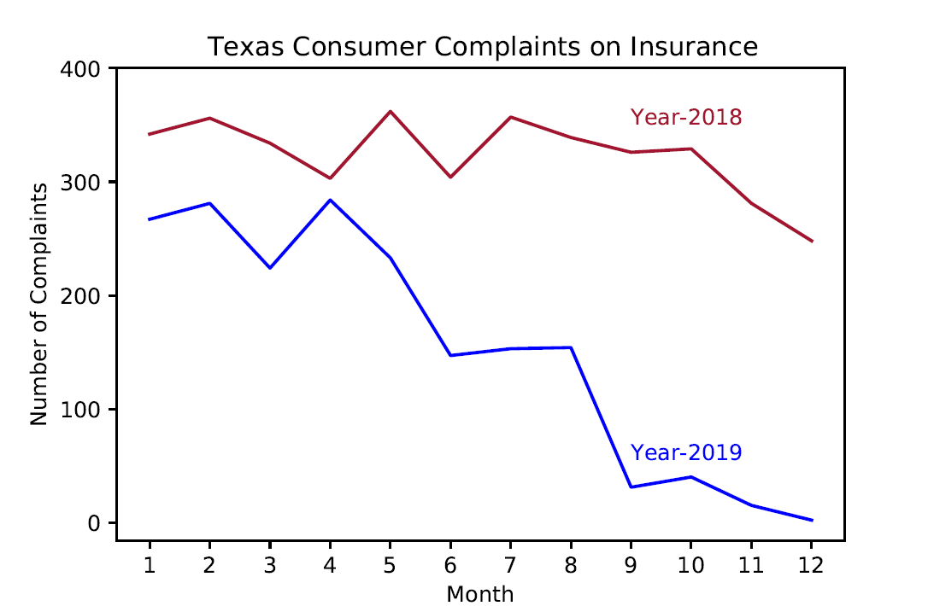
Complaints are on the decline
Exploratory data analysis techniques
Histograms, Bar charts and bubble charts
K-Modes clustering technique
Multivariable regression analysis

Slide 9
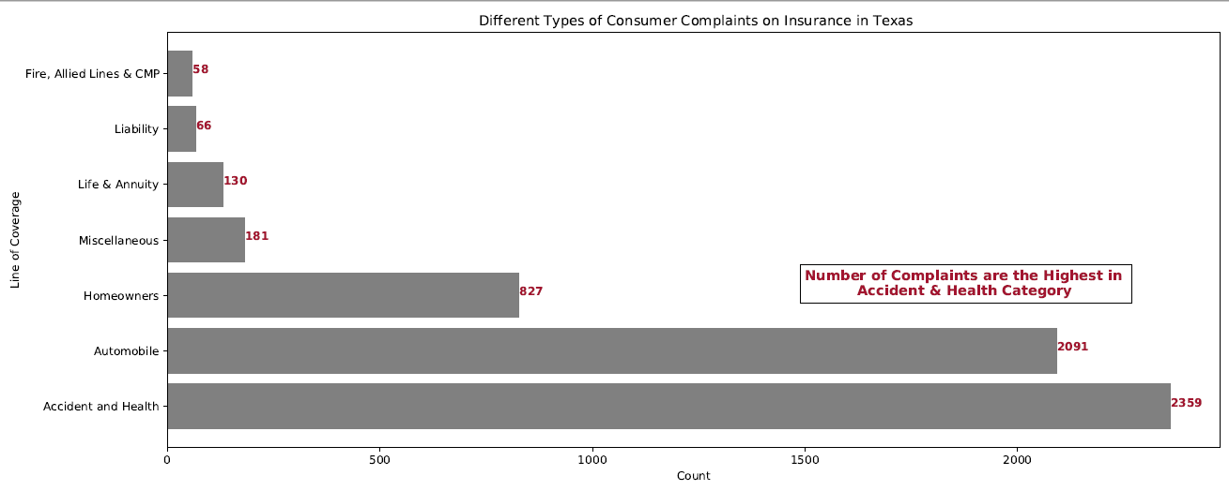
Accident & Health category tops the list

Slide 10
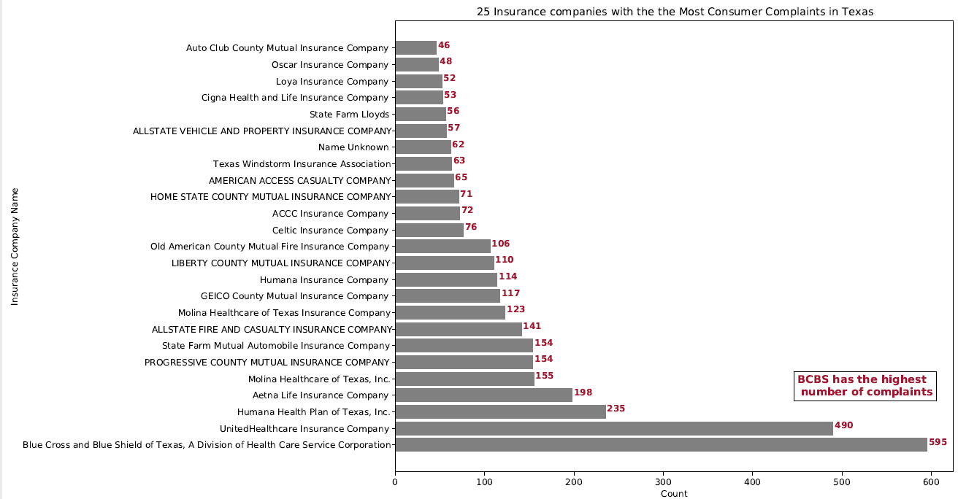
Most complaints are against BCBS

Slide 11
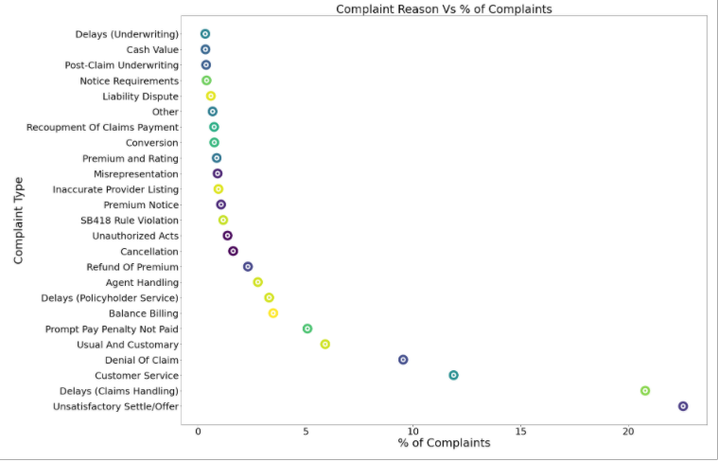
Unsatisfactory settlement is the top reason

Slide 12
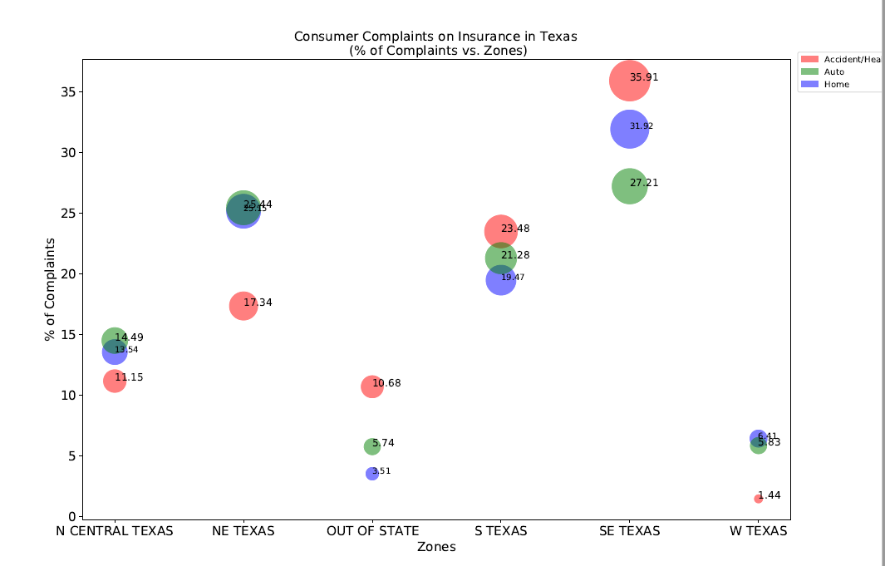
SE Texas consumers filed the highest no. of complaints

Slide 13
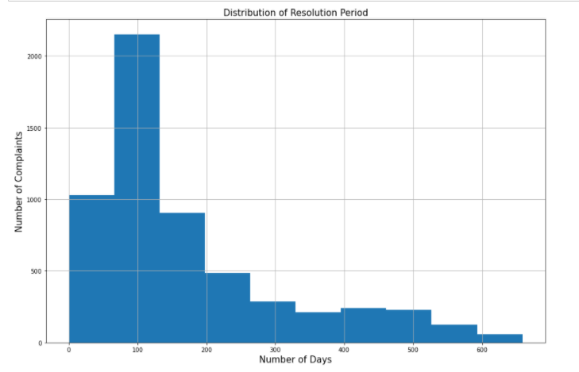
2000+ complaints were resolved in 100 days

Slide 14
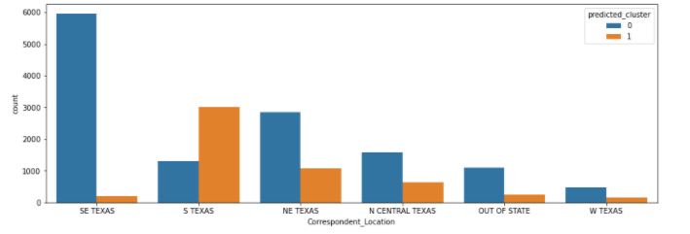
Majority complaints in SE Texas were under one cluster

Slide 15
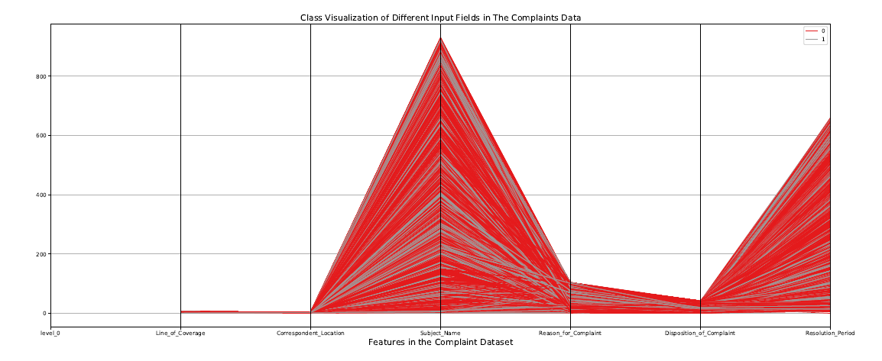
Parallel Coordinate Plot

Slide 16
Results-1
Most of the complaints were in Automobile and Accident & Health Category
Consumers in North Central & NE Texas filed more auto and home Complaints
The average resolution time for Automobile complaints was 110 days

Slide 17
Results-2
Claims were settled in 1600+ cases
Customers received additional money in more than 3600 cases
In 2 cases overpaid claims recouped

Slide 18
Results-3
Maximum resolution time was 600 days
The BCBS received most complaints followed by the UnitedHealth care
Claims handling is the 2nd most reason for filing complaints

Slide 19
Conclusions-1
Insurance companies need to work on the contract language to set clear expectations for the customers
Insurance companies need to improve customer service as it still accounts for 12% of complaints
There is a clear distinction between how consumers are filing complaints in different zones of Texas

Slide 20
Conclusions-2
Good news is that consumer complaints are in the decline
Insurance companies need to pay attention to the complaint resolution time
Customers were not satisfied with the claim handling and settlement process
Customers were getting paid additional money in the majority of the complaints

Slide 21
Conclusions-3
No correlation found between the input variables and resolution time.
All complaints were separated into two different clusters

Slide 22
Acknowledgements
Thank you
Professor Catie Williams for Feedback
Classmates for their reviews

